Slide 1
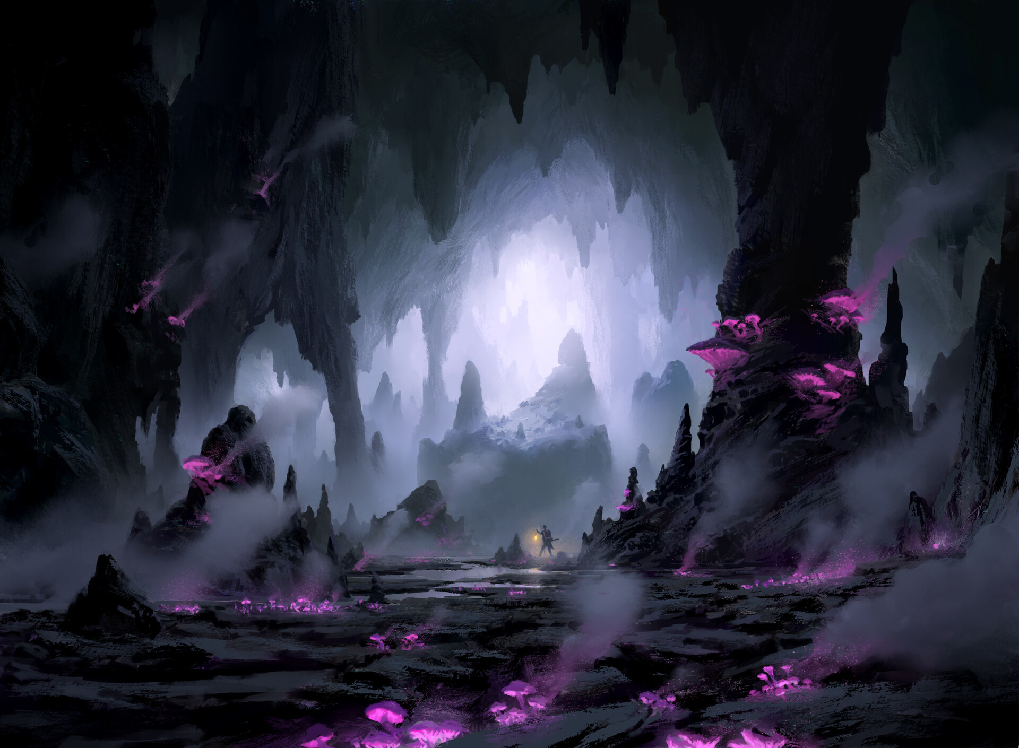
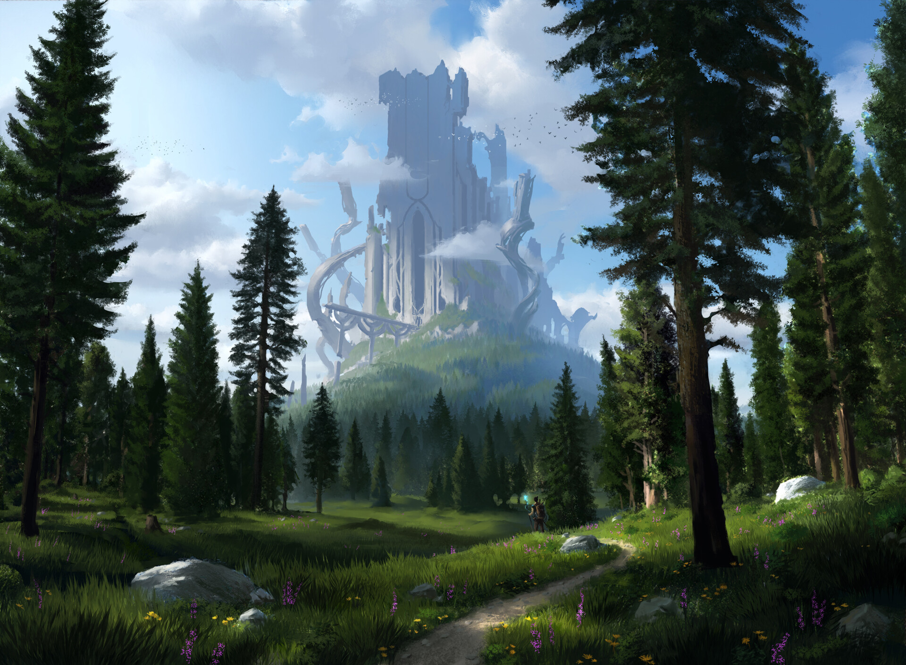
PIOTR DURA

Slide 2
PIOTR DURA
ILLUSTRATOR/CONCEPT ARTIST
Kraków, Poland
Clients list:
Wizards of the Coast
Bushiroad
Netease Games
Rhino Games Inc
MugenUp
Crush Visual
Paizo Publishing
Iron Tower Studio

Slide 3
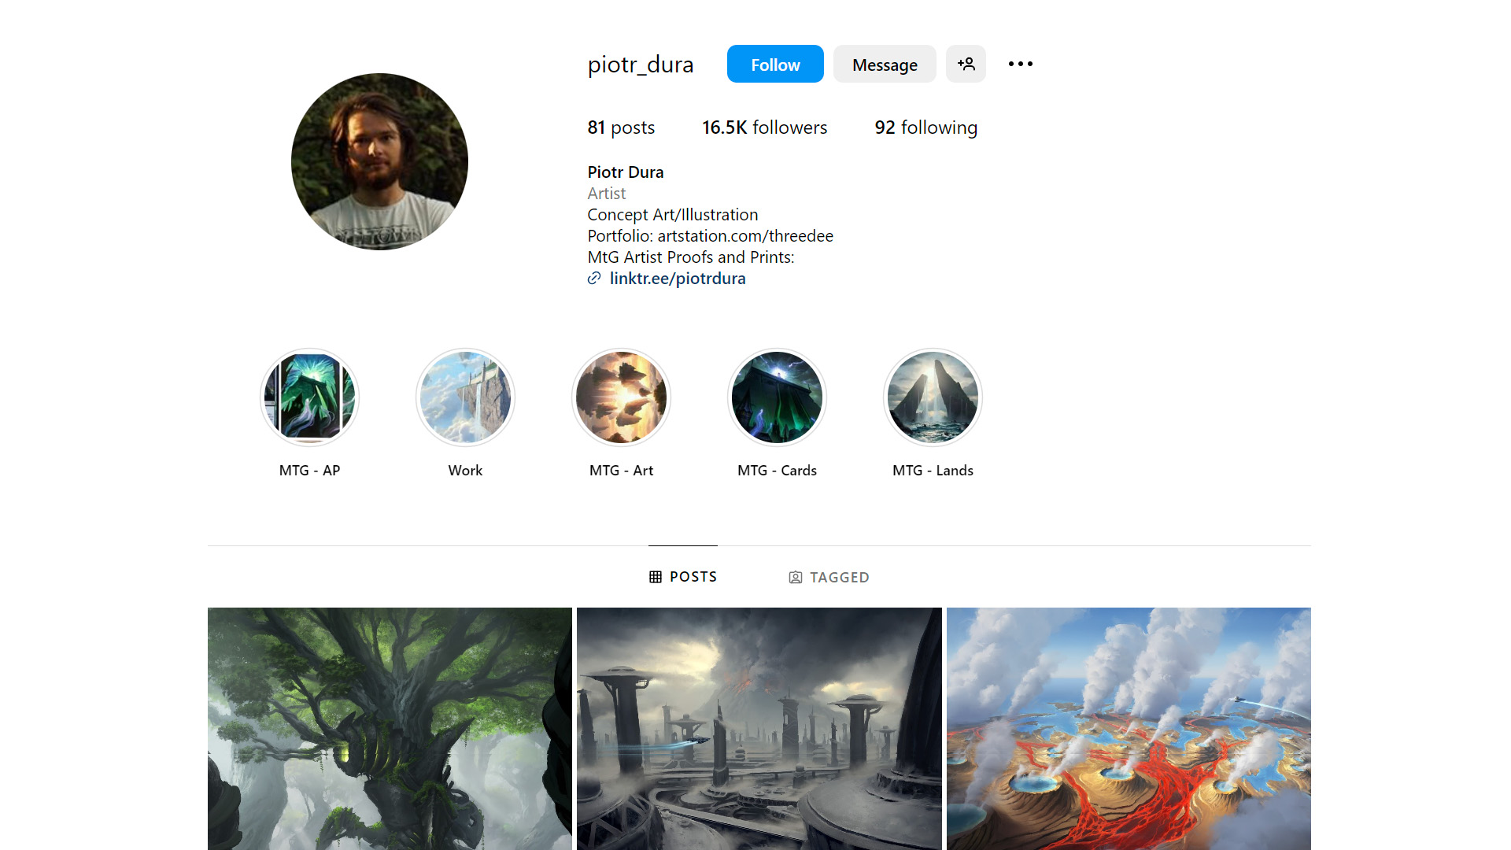

Slide 4
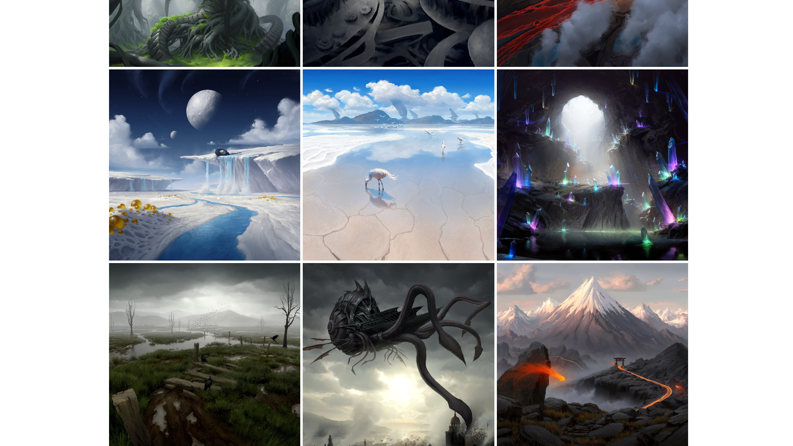
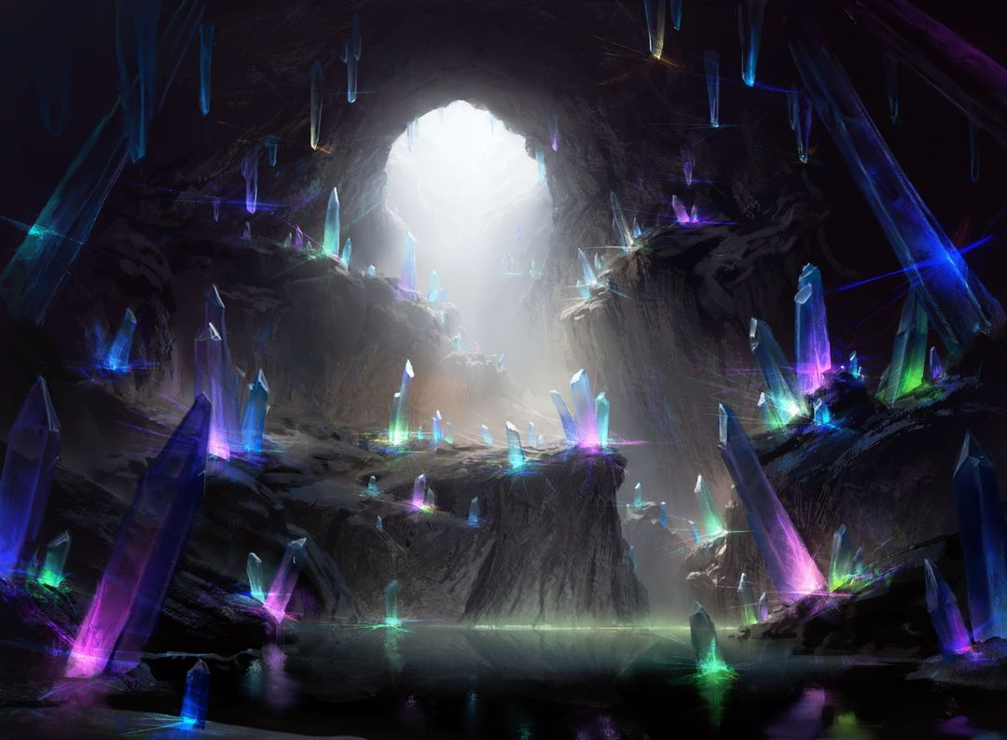
COVER PAGE
HOME
HYPE TREND
FASHION
TREND SUIT
SALES

Slide 5
COVER PAGE
HOME
HYPE TREND
FASHION
TREND SUIT
SALES

Slide 6
COVER PAGE
HOME
HYPE TREND
FASHION
TREND SUIT
SALES

Slide 7
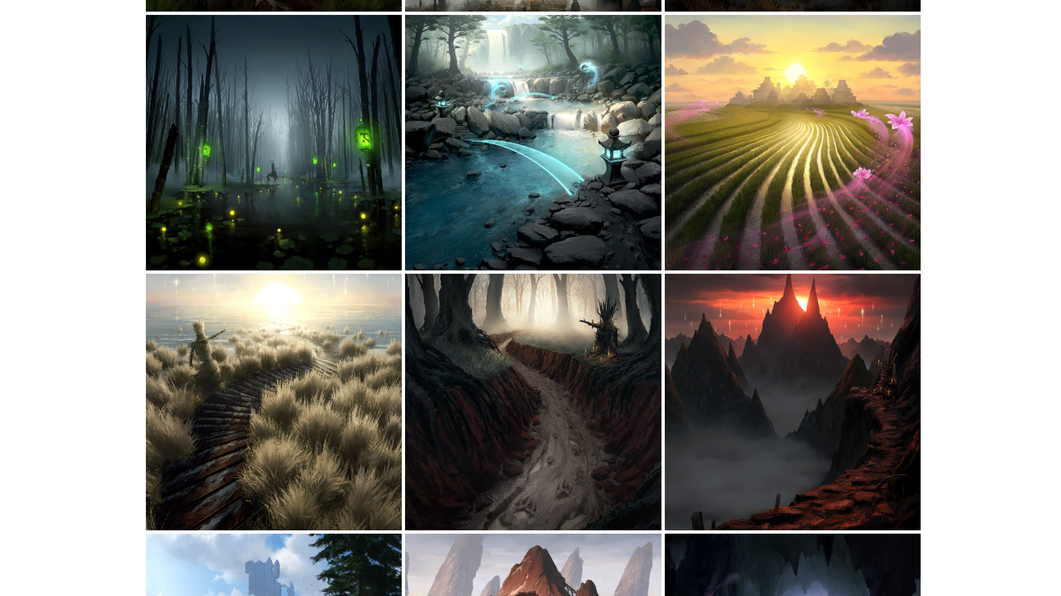
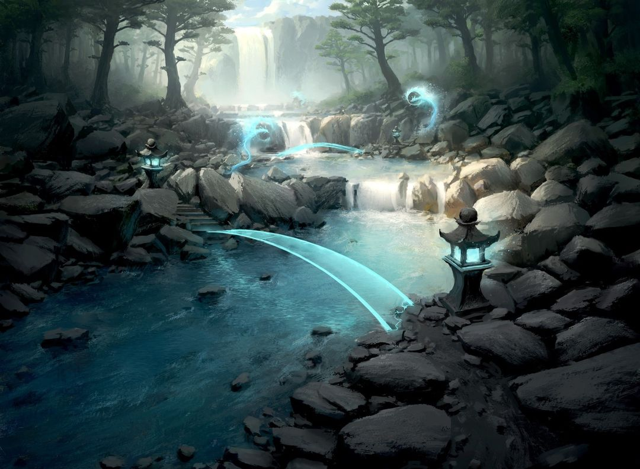
COVER PAGE
HOME
HYPE TREND
FASHION
TREND SUIT
SALES

Slide 8
COVER PAGE
HOME
HYPE TREND
FASHION
TREND SUIT
SALES

Slide 9
COVER PAGE
HOME
HYPE TREND
FASHION
TREND SUIT
SALES

Slide 10
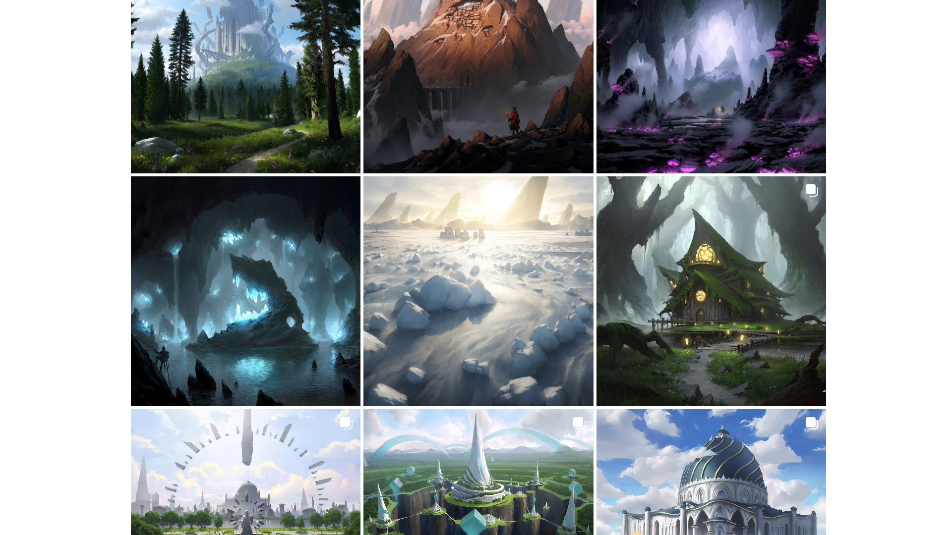
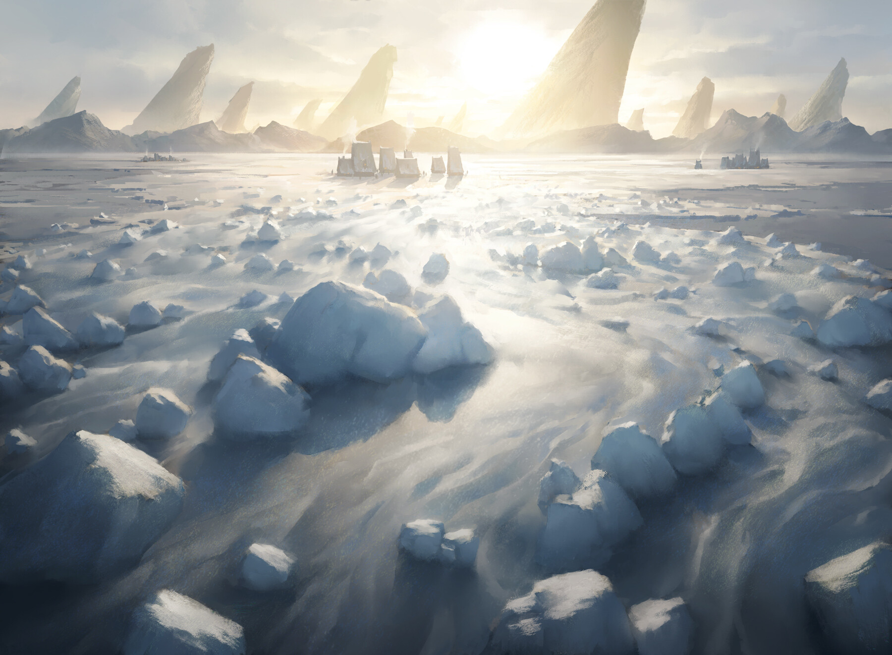
COVER PAGE
HOME
HYPE TREND
FASHION
TREND SUIT
SALES

Slide 11
COVER PAGE
HOME
HYPE TREND
FASHION
TREND SUIT
SALES

Slide 12
COVER PAGE
HOME
HYPE TREND
FASHION
TREND SUIT
SALES

Slide 13
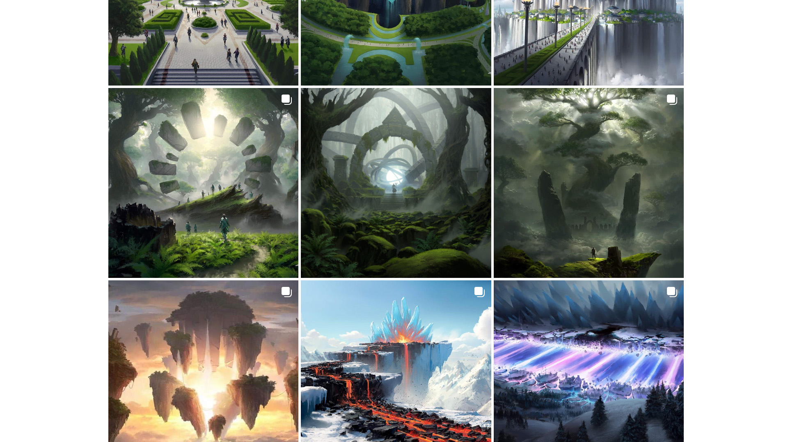
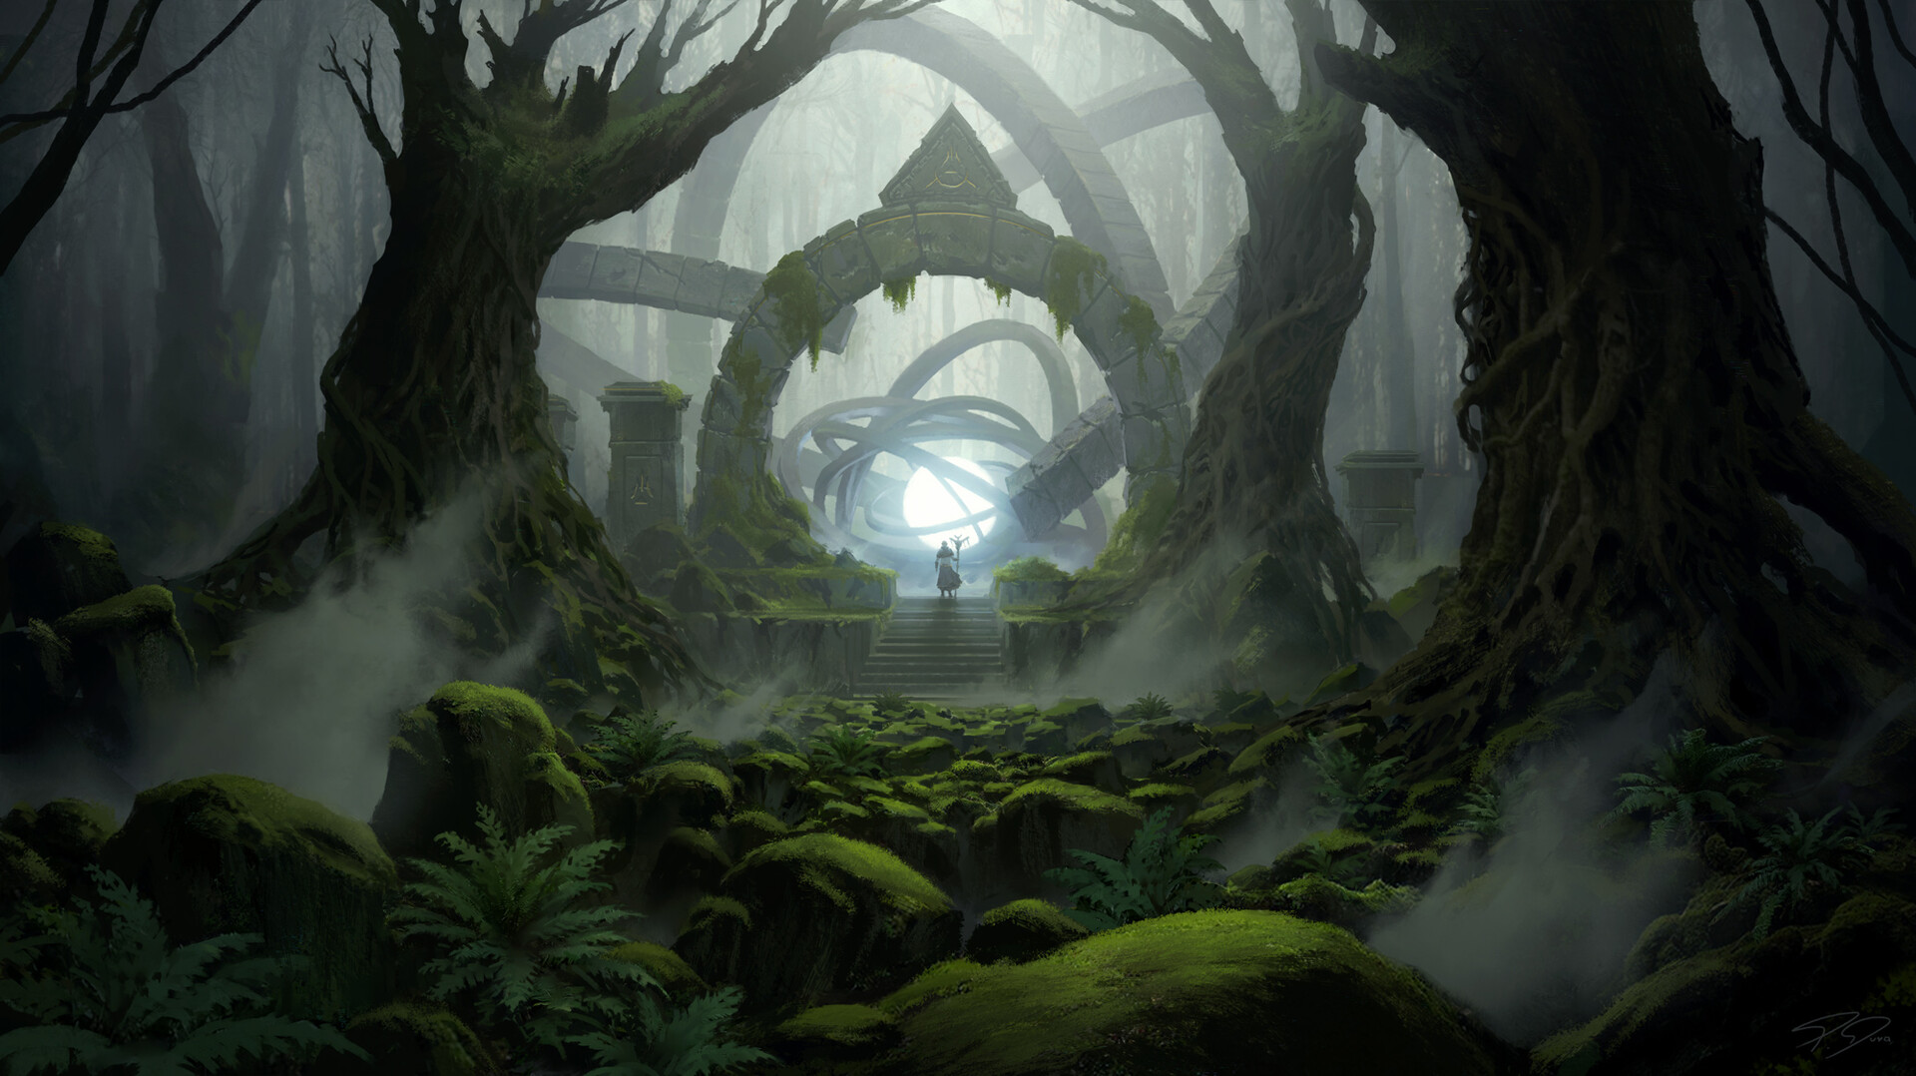

Slide 14
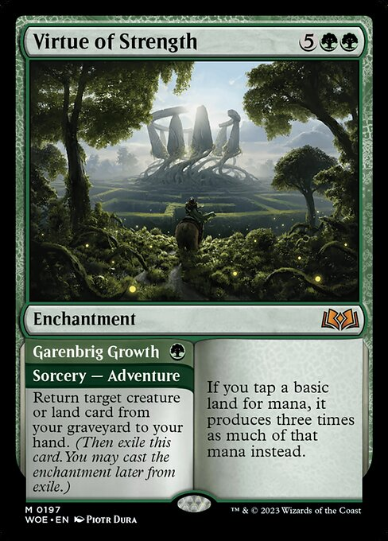
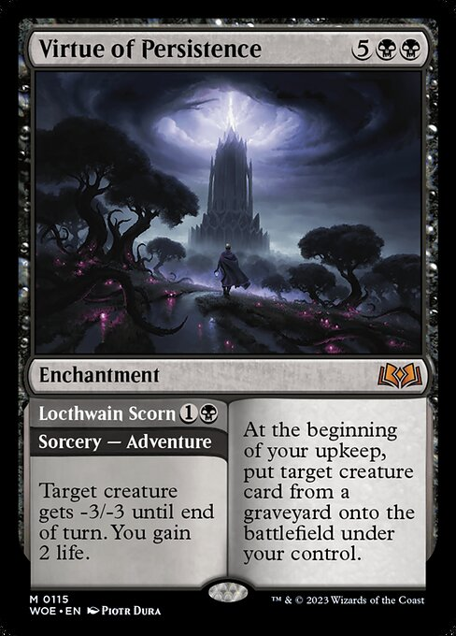
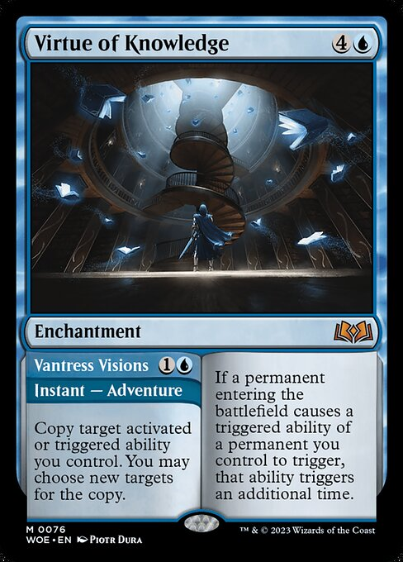
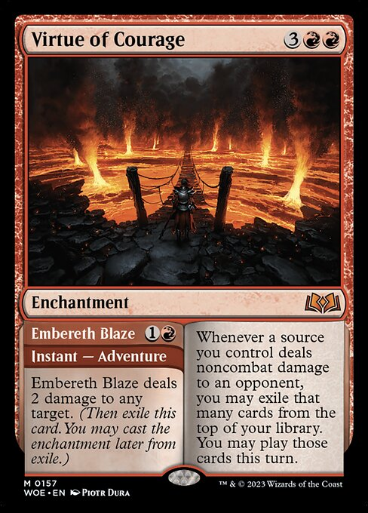
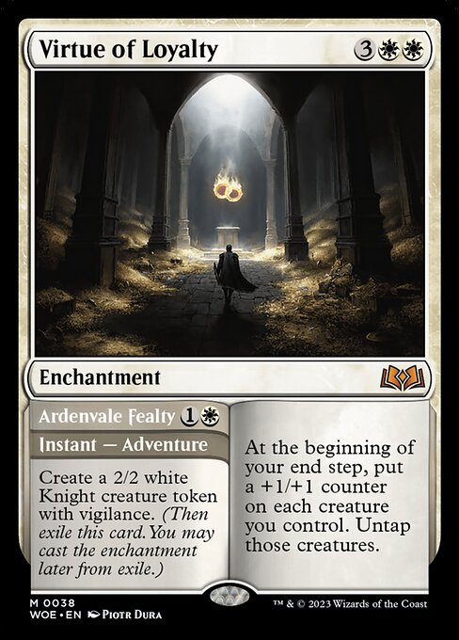

Slide 15

PERSONAL OPINION
Masterful storytelling
Strong composition and use of depth/perspective
Makes cards for my favorite card game, Magic the Gathering

Slide 16
CARDS: 263

Slide 17
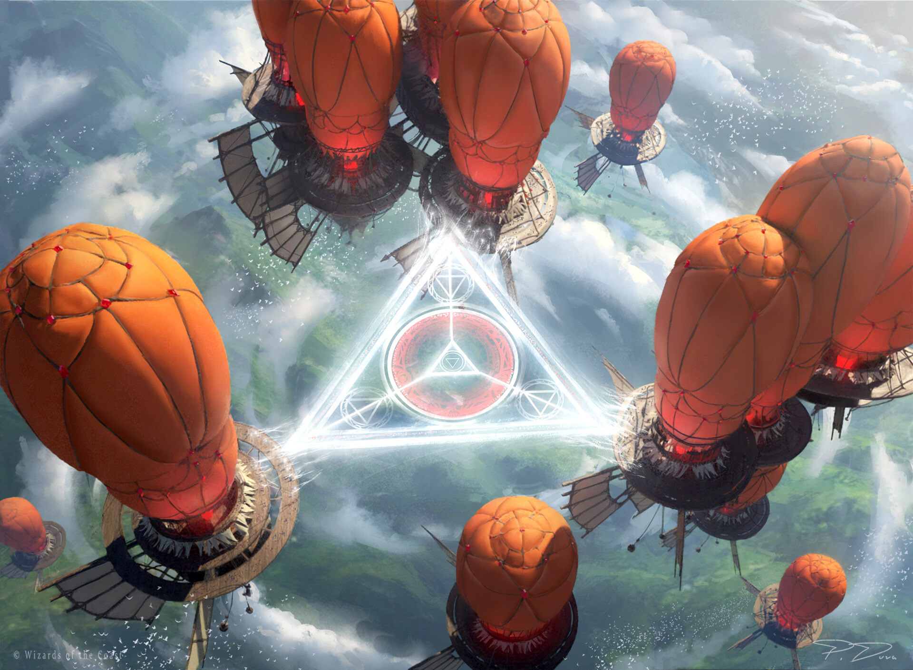
PIOTR DURA
LINKS
https://www.instagram.com/piotr_dura
https://www.artstation.com/threedee
https://www.behance.net/ThreeDeee

