Slide 1
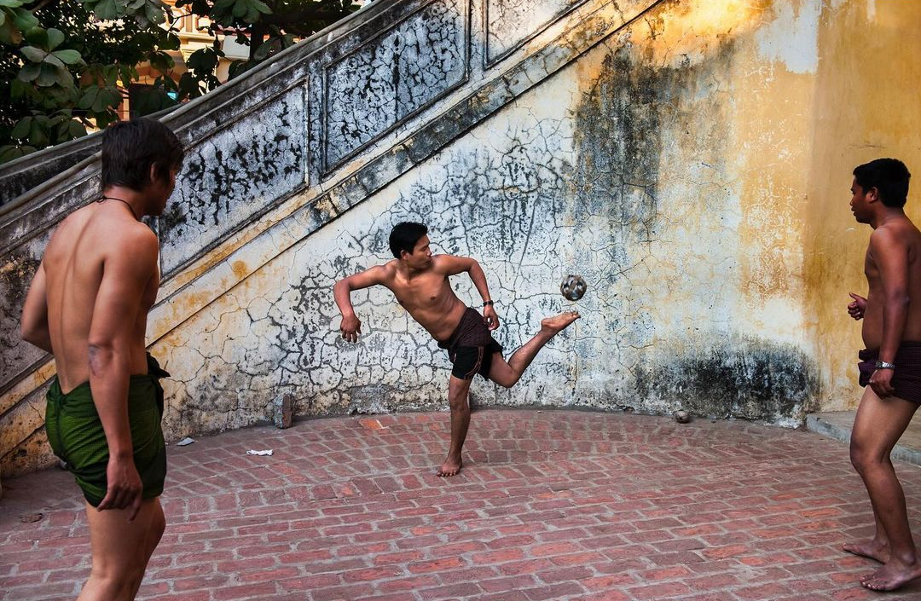
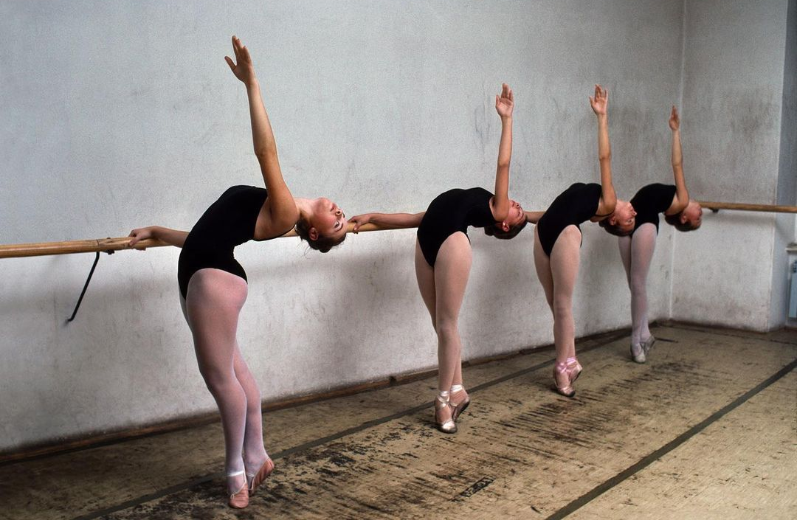
Steve McCurry

Slide 2
Steve McCurry
PHOTOJOURNALIST
Born in Philadelphia, Pennsylvania
Education
Studied cinematography at PSU
Working for a newspaper, his images were the first to show the brutality of the Russian invasion of Afghanistan
Awards
Centenary Medal for Lifetime Achievement
Robert Capa Gold Medal
International Photo Hall of Fame

Slide 3
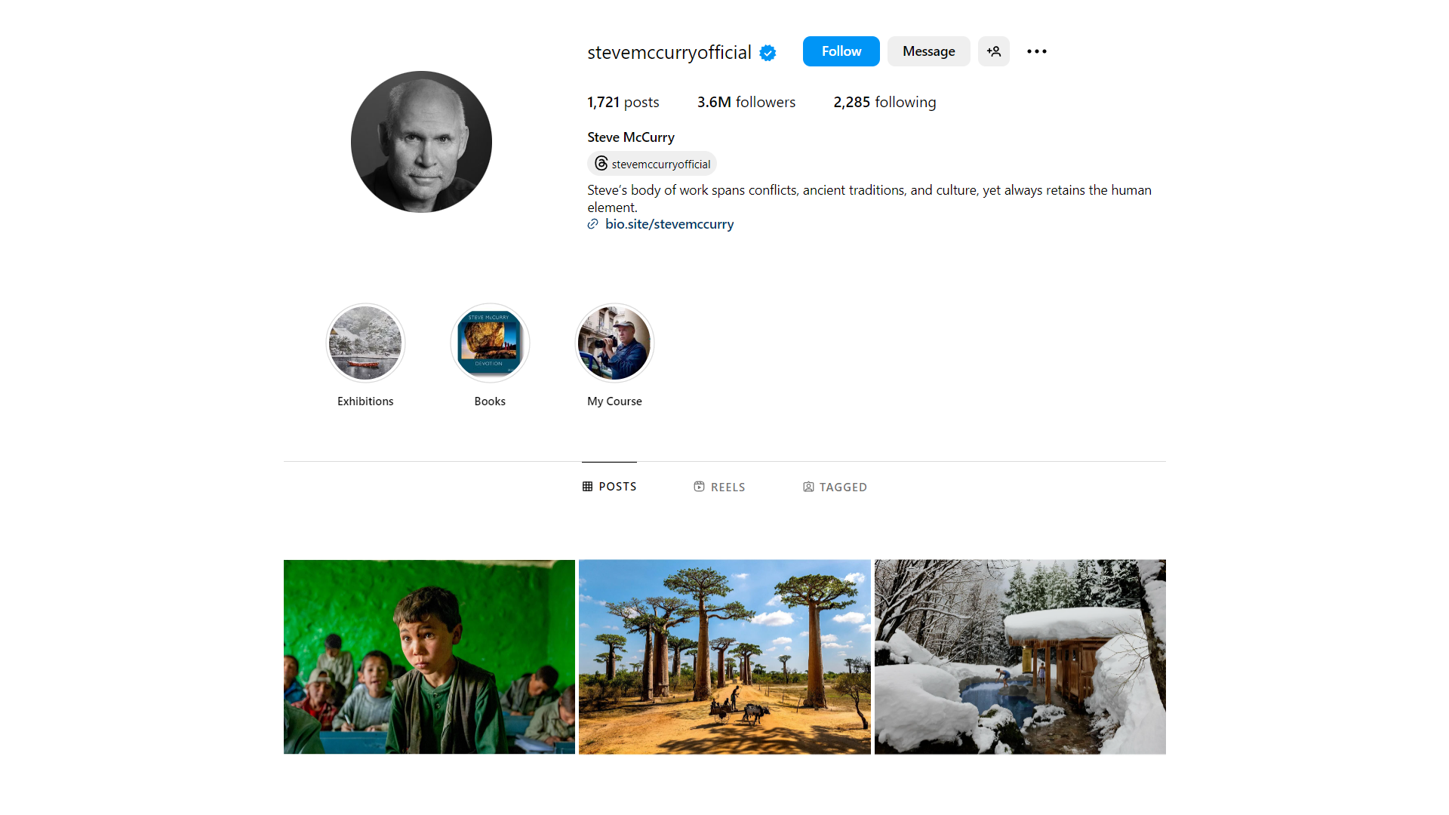
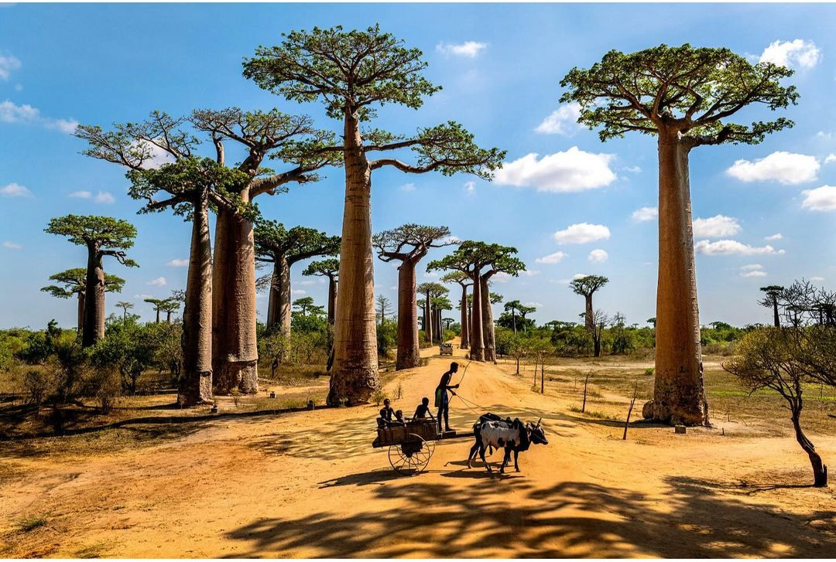

Slide 4
Figure to Ground
Leading Lines

Slide 6
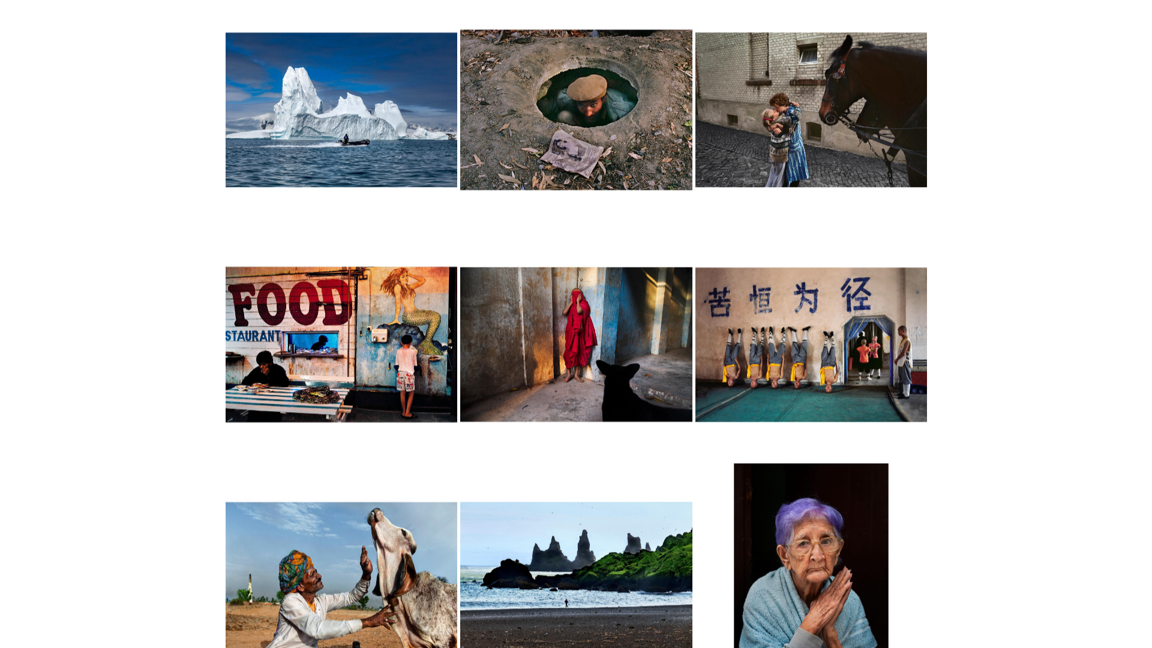
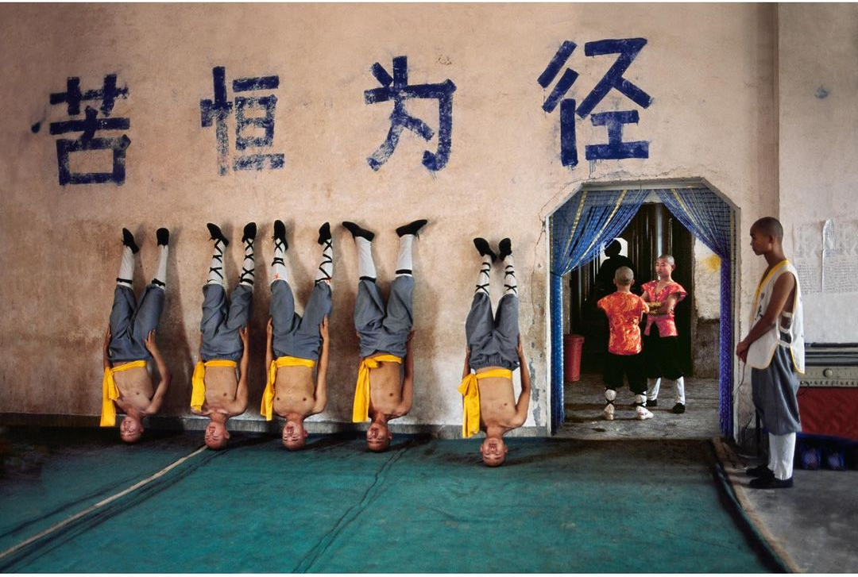

Slide 7
Patterns & Repetition
Rule of Thirds

Slide 9
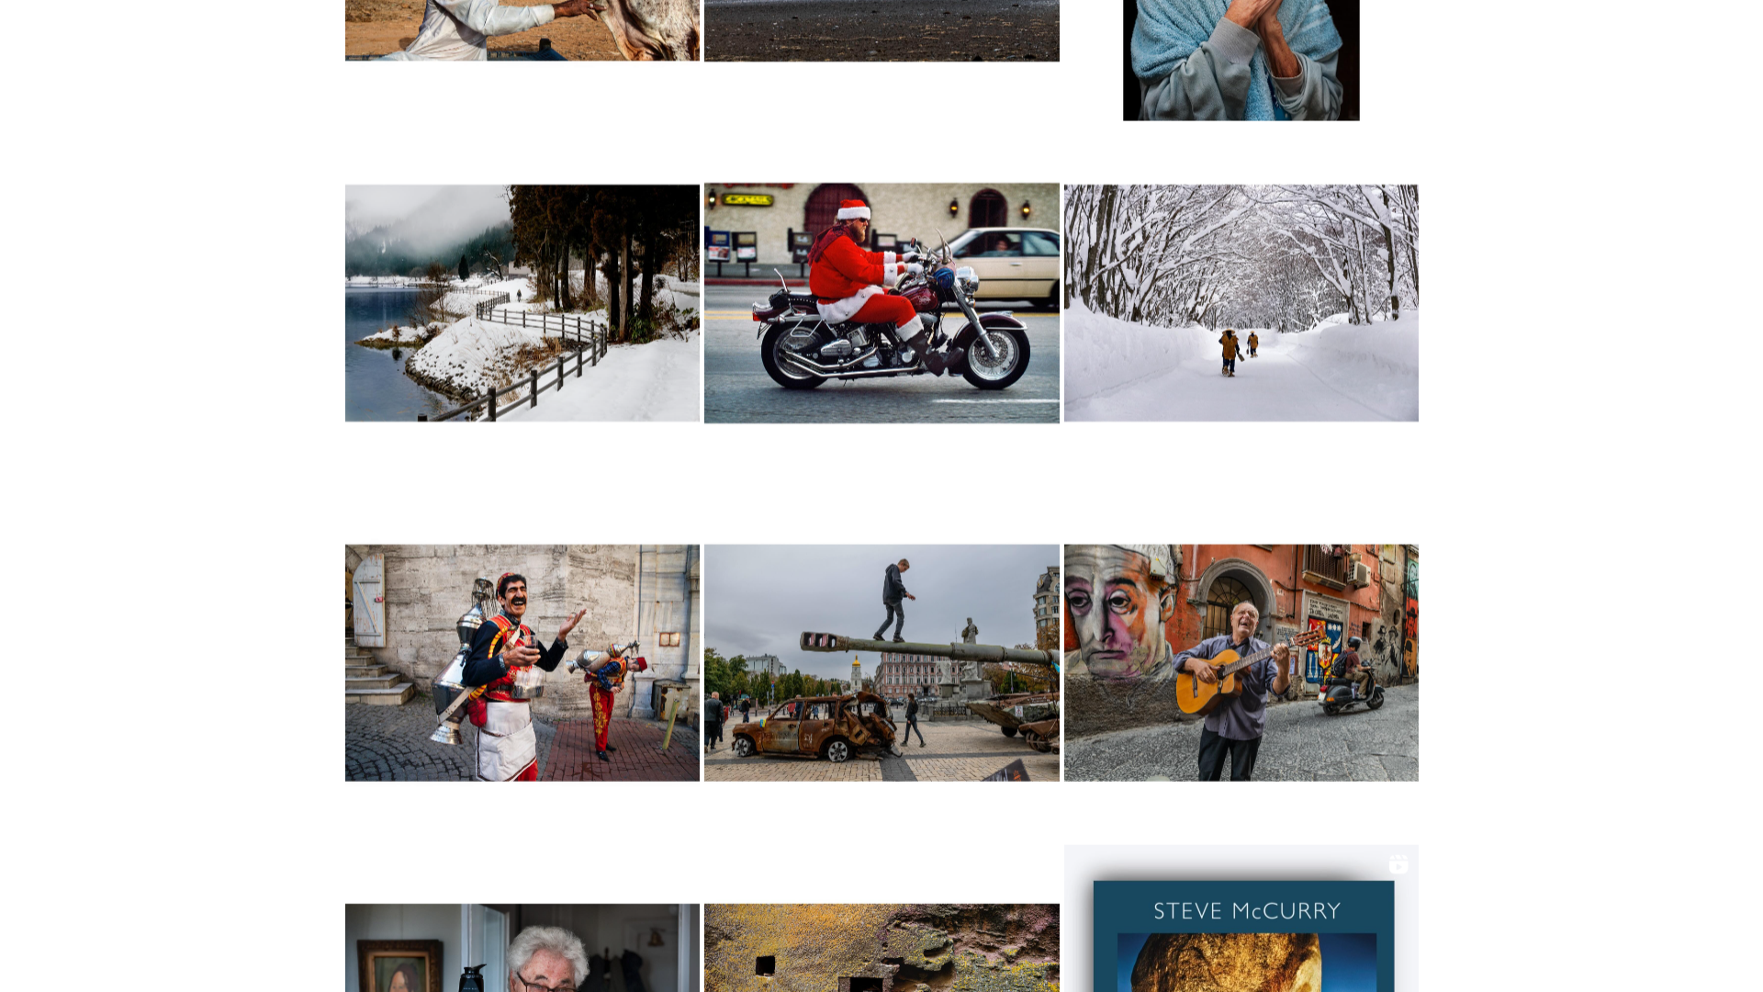
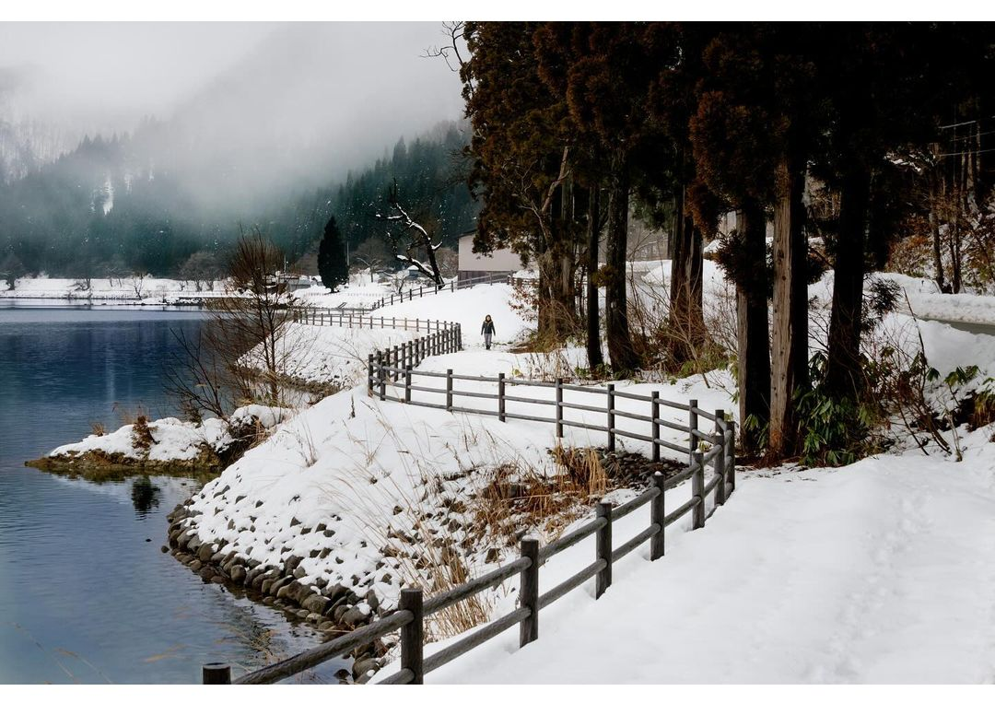

Slide 10
Diagonals
Figure to Ground

Slide 12

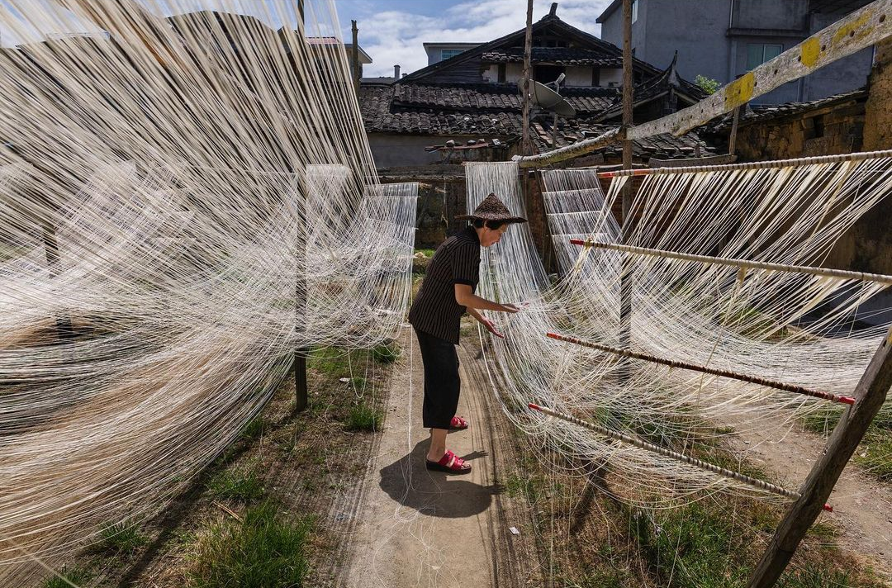

Slide 13
Framing
Leading Lines

Slide 15

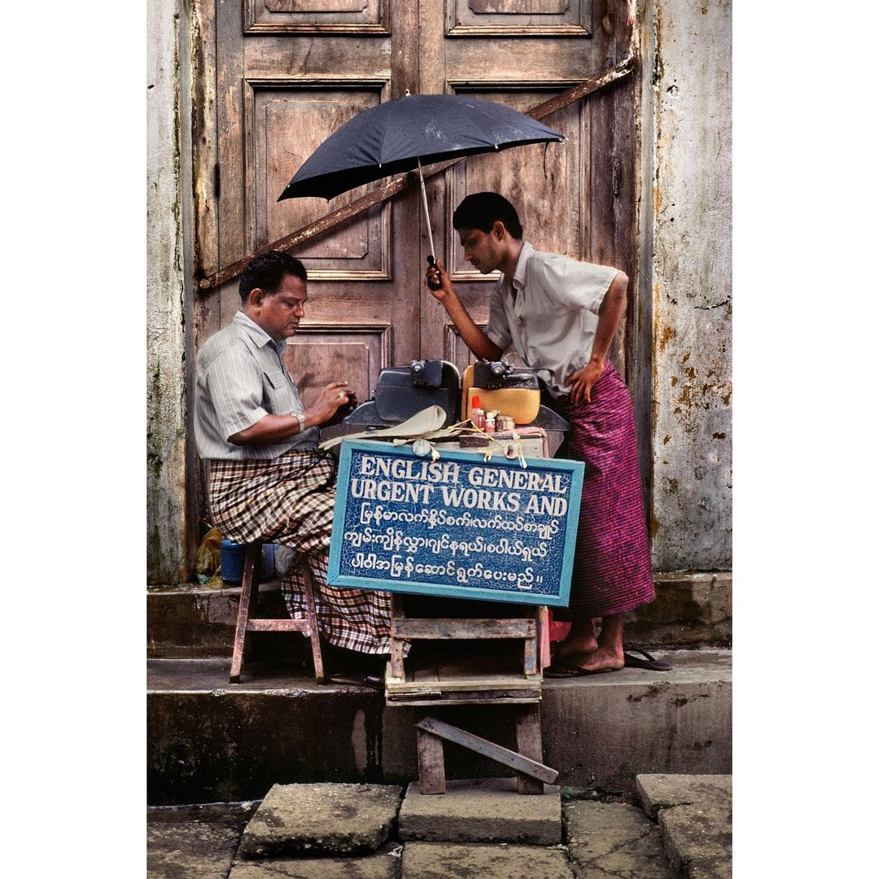

Slide 16
Framing
Rule of Thirds

Slide 18
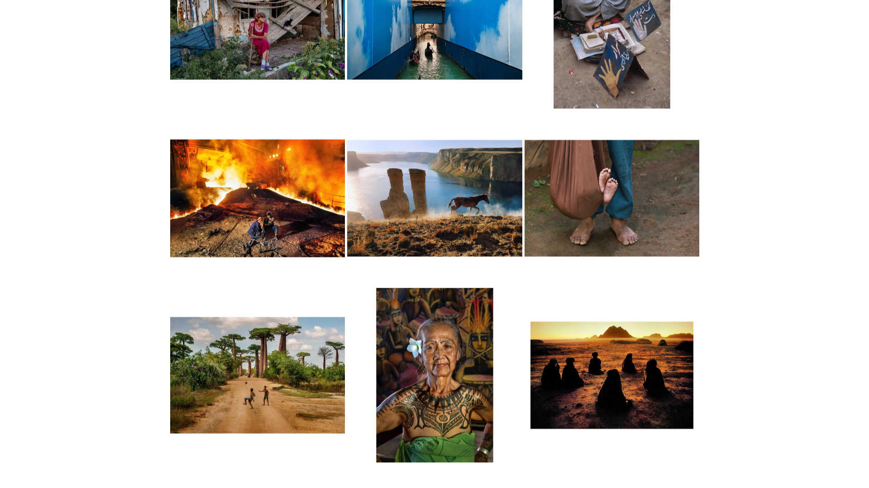

Slide 19
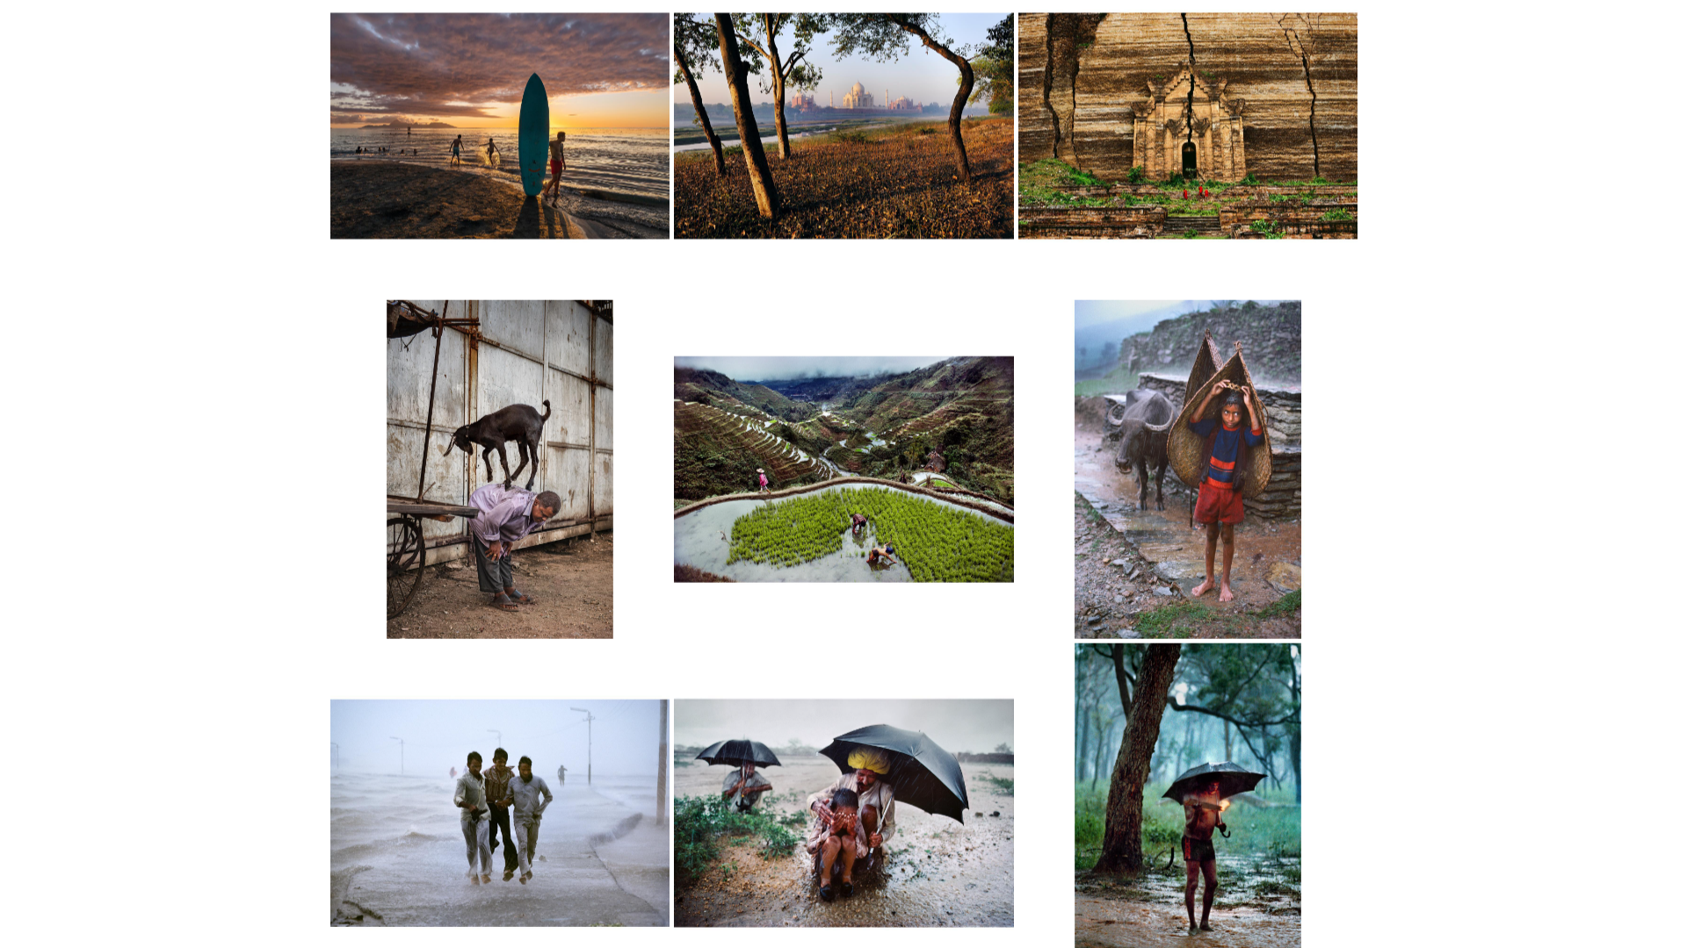

Slide 20


Slide 21
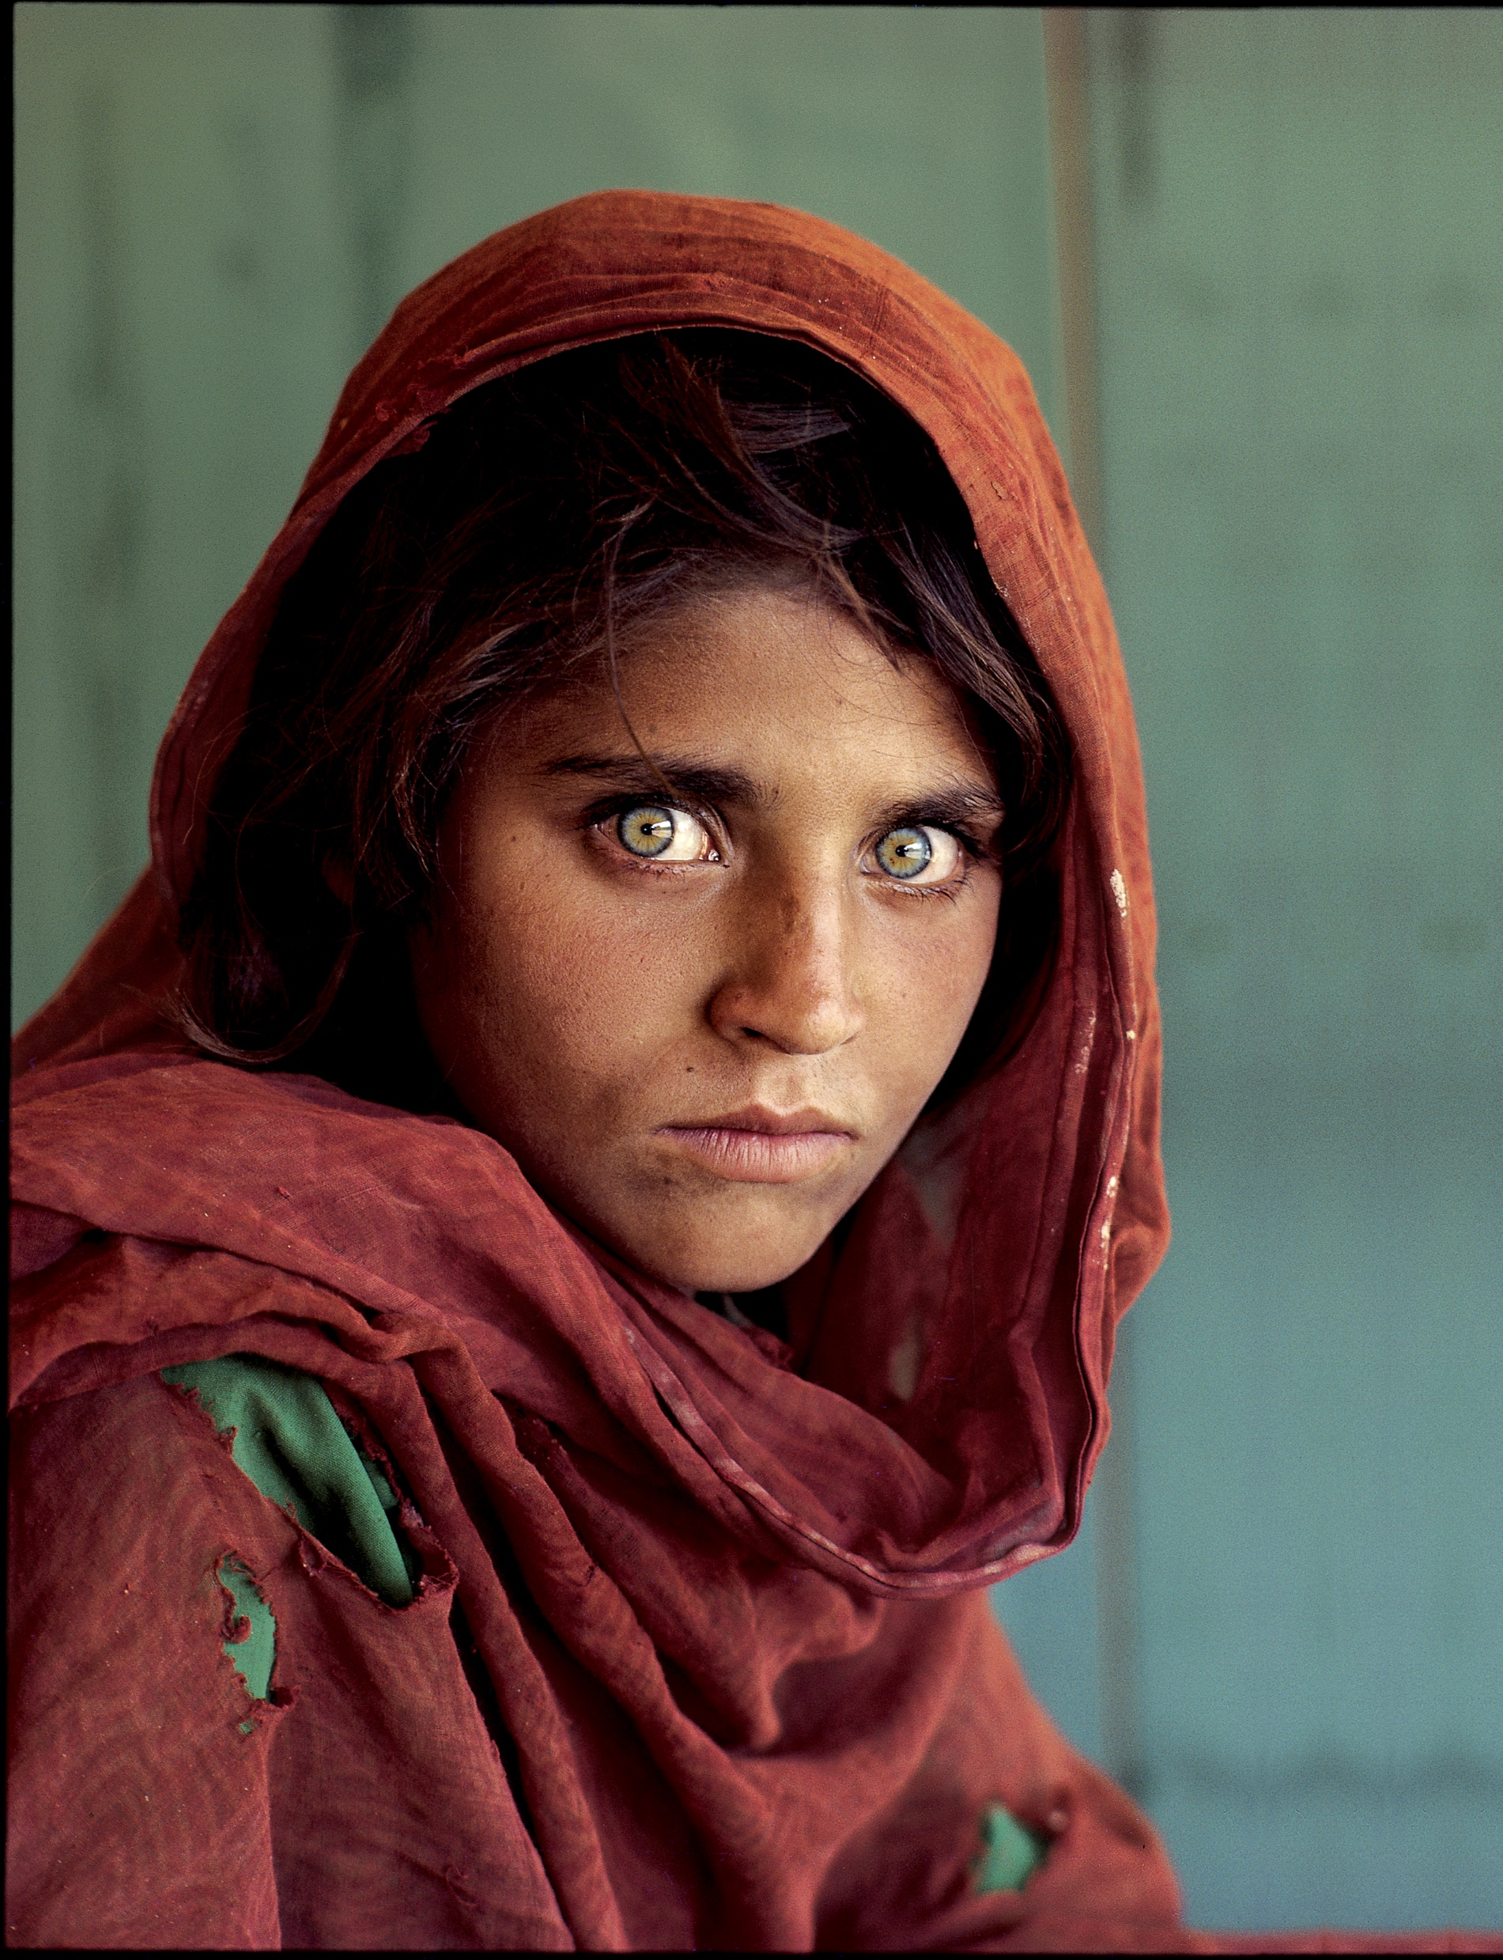


PERSONAL OPINION
Masterful storytelling
Strong composition and use of color
Maker of the most famous photograph, Afghan Girl

Slide 22

Steve McCurry
LINKS
stevemccurry.com
instagram.com/stevemccurryofficial

